Slide 1
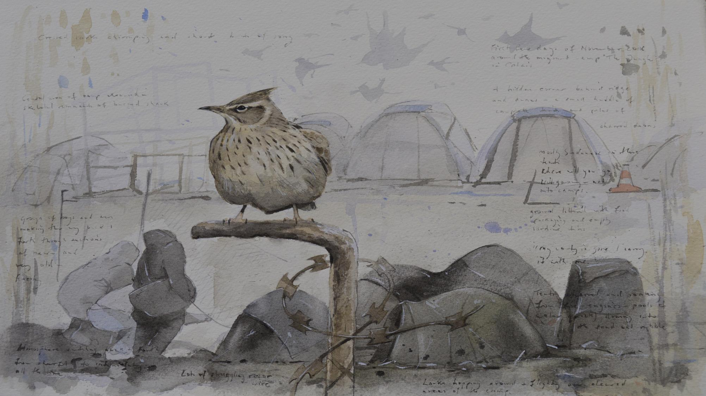

Gloucestershire Action for Refugees and Asylum Seekers.
Established 1999

Slide 2
A remarkable and
inspiring story
spanning
25 years

Slide 3
Where it all began …… July 1999
Local people from different faiths and Amnesty groups meet to set up a dedicated support group in response to the needs of an increasing number of asylum seekers requiring support in Gloucester.
It is named Gloucestershire Action for Refugees and Asylum Seekers because it is about being active in the work carried out. GARAS opens at The Trust Centre in Conduit St, Gloucester. Many of the early clients come from the break-up of the former Yugoslavia, particularly Kosovans, Croatians and ethnic Albanians.

Slide 4
2000
GARAS employs its first two employees, Kirsten as Co-ordinator and Farouq as an Advice Worker, to respond to the increasing demand of clients needing answers to their questions.
GARAS continues to also assist with emergency support and regular activities including much needed ESOL provision.

Slide 5
2001
GARAS moves to the former Labour Club on Barton St when The Trust Centre building becomes a Sure Start Centre. The Labour Club had run out of funds and had been left with half drunk glasses and cigarette butts in ash trays, so it needed a lot of cleaning and preparation!
It proves to be a great location from which GARAS supports over 400 people in this year alone. GARAS shares the building with Gymnation (later to become The Friendship Cafe).

Slide 6
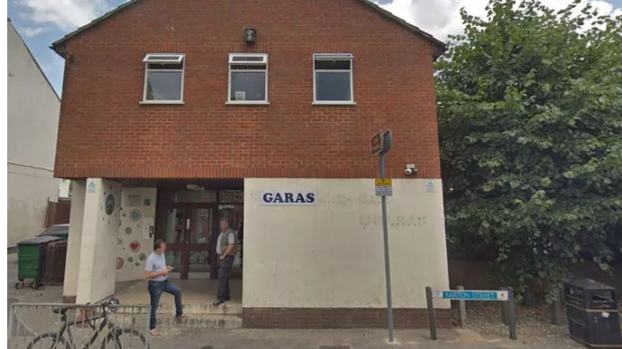

Slide 7
2002
The NASS (National Asylum Support Service) for asylum seekers is being rolled out across the country, which changes the nature of dispersal and means that contracted companies will provide the accommodation for all asylum seekers.
GARAS starts a youth project supporting youngsters from client families. GARAS is now registered with a Quality Mark and has its first audit to provide advice at Level 1 in Immigration and Asylum Work.

Slide 8
2003
Kirsten resigns from her role and Adele is appointed as Director of GARAS.
GARAS begins to provide counselling support for those living with multiple loss and trauma as a result of their lived experiences.

Slide 9
2004
GARAS is able to employ a Finance Officer, Terry, and another member of the advice team to work with the new arrivals coming into ClearSprings Ready homes. This is a British company which provides housing services, primarily for the Home Office.
In May, ten more countries are added to the EU resulting in a significant amount of extra work as we ensure that our clients from countries including Czech Republic, Poland and Slovakia do not become homeless and can safely remain with the change to their status.

Slide 10
2005
GARAS employs a Women’s Worker - Rachel C joins the team.
The stories we are hearing and the needs of women we are meeting, specifically from the Democratic Republic of Congo, means this targeted supportive work is becoming vital.
This is the first year that clients start to experience the British Citizenship tests and ceremonies.
GARAS hosts its first social work students on placement.
GARAS is able to reunite a couple who had been separated by war after 6 long years.

Slide 11
2006
More changes in legislation and policy by Government.
We provide ESOL classes at each of our drop-in days.
We also provide IT classes and access to computers for clients.
GARAS starts a sewing group run by a former client - a vibrant encouraging group of women supporting each other.
A change in the way the housing provider works means we lose some funding resulting in reducing staff and cost cutting exercises.

Slide 12
2007
In a year that commemorates the Abolition of the Slave Trade it is becoming more and more apparent that human trafficking remains a real issue in Gloucestershire.
Working with two housing providers reveals some shocking conditions that people are living in and we are glad when one contract is cut short.
GARAS starts a pilot project with Supporting People (a UK government programme helping vulnerable people live independently) to assist those who, having received their Leave to Remain, need support as they move on.
(Gloucester Floods - GARAS is able to stay open!)

Slide 13
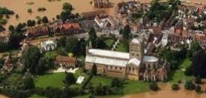
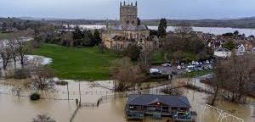
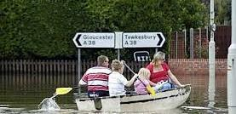
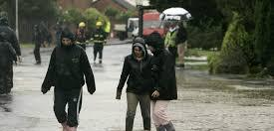
Gloucestershire Floods 2007

Slide 14
2008
GARAS starts to work more with a growing number of Unaccompanied Asylum-Seeking Children (UASC).
We begin a bridging course to help the young people prepare for life in the UK and start to work closely with a newly re-formed asylum team at Social Services. Many of the young people GARAS see have found their way to Gloucestershire in very difficult and dangerous ways, including under lorries.
A legacy backlog project starts to work with those who have been waiting for decisions for many years.

Slide 15
2008 continued
GARAS is able to employ another Advice Worker, Hannah, to work with these families as an extension of the Supporting People work.
GARAS also works with Refugee Action on Refugee Integration and Employment Service (RIES) to assist clients into employment and training.
The GARAS team is devastated by the death of a young man who, due to the challenges of accessing medical care, died of a treatable condition.

Slide 16
2009 - GARAS is 10 years old.
Austerity cuts see the early closure of the RIES programme!
We partner with ArtShape on a programme of creative projects including the Barton Street Recordings –recording songs in a variety of languages along with an animated cartoon of Barton Street.
Azure Cards are introduced to replace vouchers and there is an increase in those with No Recourse to Public Funds (NRPF), adding to our workload.
We fit a shower to give new arrivals dignity and provide a change of clothing for them.

Slide 17
2010
GARAS appoints a new UASC worker, Rebecca, to co-ordinate legal representation for UASC, challenge age assessments and implement a new arrival protocol (amongst other changes) that continue to have an impact 14 years later.
We see further impact of the austerity cuts and yet another change in Immigration law from Government.
Our neighbour in Bristol, Refugee Action, has to cut back most of it’s work following an 80% cut in funding.
We begin to experience the impact of Legal Aid cuts.

Slide 18
2011
GARAS starts to work with FareShare, a community-based project, to provide food otherwise destined to go to landfill. Once a week GARAS distributes food that further assists the vulnerable people we support.
After 7 years of separation of a client from her children, they are able to reunite after a long and painful battle.
GARAS appoints a part time nurse to work with clients living with or affected by HIV, to support individuals attending appointments and ensure they are getting their medication and maintaining their medical regimes.

Slide 19
2012
It is a year that is deeply affected by rising homelessness and Welfare Reform cuts, meaning those being granted refugee status now struggle to get the basics for furnishing and essential items.
A highlight is Harts Barn in the Forest of Dean offering a bread making course to clients living with the effects of trauma.
Theresa May (then Home Secretary) states “the aim is to create, here in Britain, a really hostile environment for illegal immigrants".

Slide 20
2013
Following the move by The Friendship Cafe to Chequers Bridge, GARAS takes a leap of faith and takes over the entire building at 111 Barton Street, Gloucester.
This enables extra activities to be offered and gives ESOL lessons the necessary space required.
Sadly, one of the founders of GARAS, a long-time friend, volunteer and Trustee, Barbara Kew, passes away. She remains well remembered by all who knew her.

Slide 21
2014
GARAS sees the Immigration Act 2014 come into force, which includes combining Asylum Claims with Human Rights in the initial decision-making process.
We also see a growing awareness of the rising tragedies happening in the Mediterranean.
GARAS restarts the Sewing Group where clients are able to learn sewing skills and share a meal together each week.
GARAS hosts the Hate Crime and Incident project.

Slide 22
2015
This year sees the launch of an entirely new area to GARAS work as we start the Syrian Vulnerable People’s Resettlement Scheme. This need grows as a result of the tragedies of clients fleeing the civil war in Syria culminating in the death of little Alan Kurdi.
GARAS is blown away by the generosity and support of people as we work to help find and prepare homes and welcome those who can arrive on “Safe Routes”.
Amina, Danijela and Ismail join GARAS as our first Resettlement Officers.

Slide 23
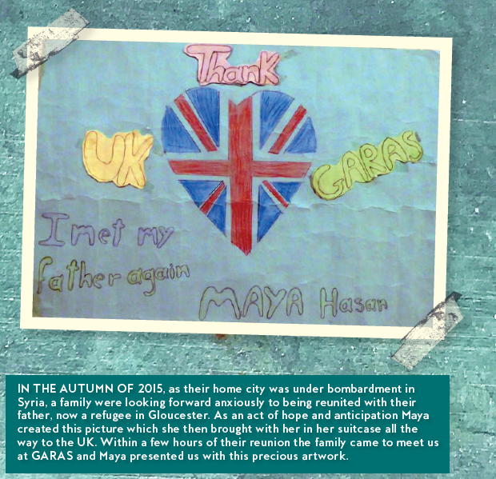

Slide 24
2016
This year sees us build on existing work and develop the Resettlement Scheme as more families start to arrive. By the year end we are supporting over 20 families.
GARAS’s Hate Crime work ends and is moved to Victim Support.
A counselling team is established in response to the increasing need for therapeutic support.

Slide 25
2017
GARAS works with the GEM (Going the Extra Mile) project to assist clients with employment, training and volunteering needs. Sarah is appointed to run the project.
Developing mental health support for all includes working with young people and providing group work to support each other.

Slide 26
2018
This is a year that sees the Windrush Scandal deny rights to those who had spent a lifetime here in the UK. It is dreadful for all affected.
In our women’s work we work with a local GP to provide workshops to trainee GPs, midwives and health visitors. GARAS finds this collaborative work extremely helpful for the clients.

Slide 27
2019
In April, GARAS moves back to it’s first home in the Trust Centre.
As reported by the BBC, we broke the Guinness Record for the greatest number of people from different nationalities all in one hug!

Slide 28
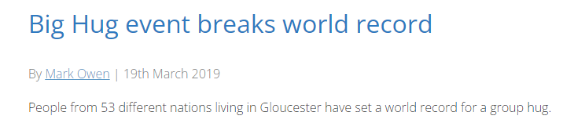
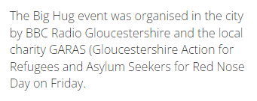

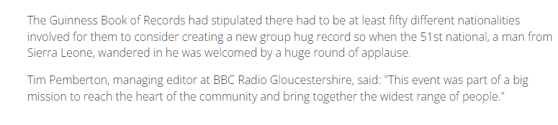

Slide 29
2019 – GARAS is 20 years old
Several successful exhibitions and events are organised under the heading of “The World on our Doorstep”
  An exhibition by Derek Robertson at Nature in Art
  An event marking 80 yrs since the Kindertransport
  Our own exhibition celebrating the history of refugees coming to the county
  An exhibition of refugee art at Gloucester Museum

Slide 30
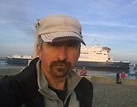
2019 GARAS Refugee Week celebrations
Groundbreaking Migrations exhibition at Nature in Art by Derek Robertson
“ I did a series of sketches around Calais and the Jungle migrant camp there over a number of days as the camp was pulled down and the remaining sections were smouldering or on fire. I accompanied members of the charities Calaid and Care4Calais and did some art activities with the unaccompanied children in the camp who were still being registered for settlement in official camps or for asylum in the UK. I completed a lot of sketches of birds migrating as well as general views around camp with small crowds of Sudanese and Afghani children watching over my shoulder. The imagery of birds migrating through a smouldering wasteland and over razor wire fences was profound and moving."

Slide 31
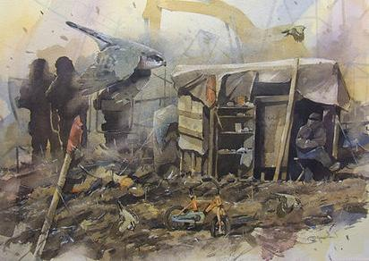
"Les Petits" was sketched on site in the Jungle refugee camp in Calais. Migrating birds such as goldcrests were flying through the scrub bordering the camp and a sparrowhawk was hunting them. The sparrowhawks also migrate with the smaller birds - predating them on their journey. "Later that day I was taking part in an art activity with refugee children when there was a sudden flurry as first the few girls in the camp and then the smaller children crouched and darted away behind the taller men. It was a like a predator response. All at once, there was a hail of stones, and a riot broke out. A crowd ran past us, away from trouble and then another group rushed forward brandishing knives and iron bars." Watercolour. 45 x 55cm framed.

Slide 32
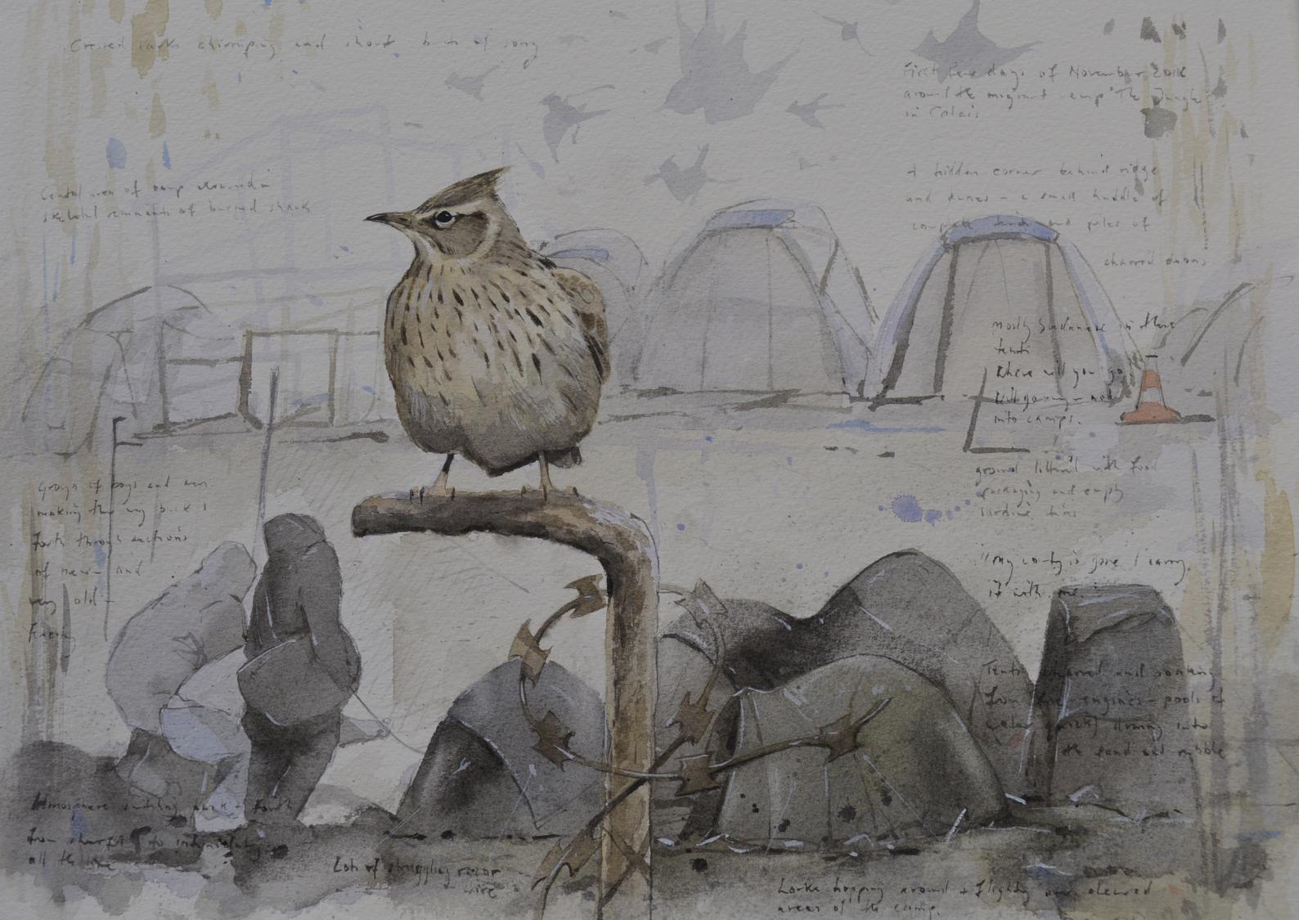
"Singing Under The Same Sky“ Watercolour painting worked up from sketches made in Calais.

Slide 33
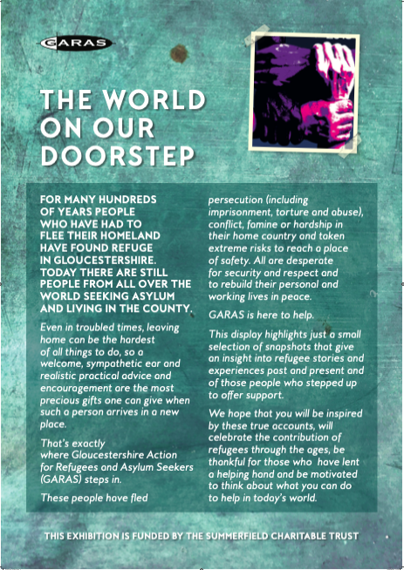
2019 GARAS Refugee Week celebrations

Slide 34
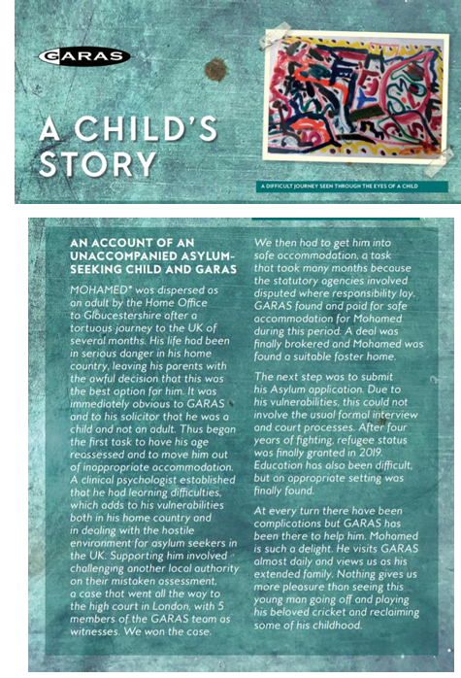

Slide 35
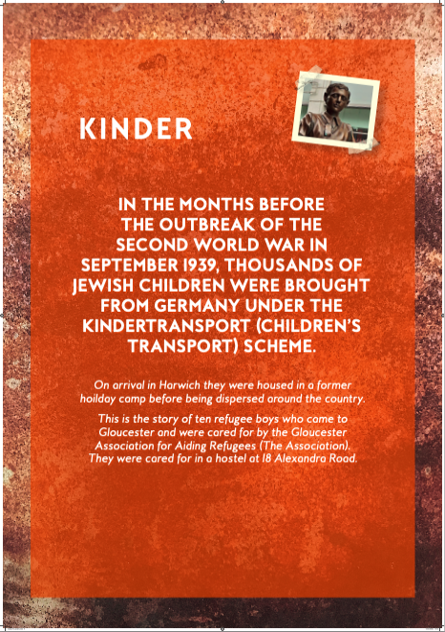
2019 GARAS Refugee Week celebrations

Slide 36
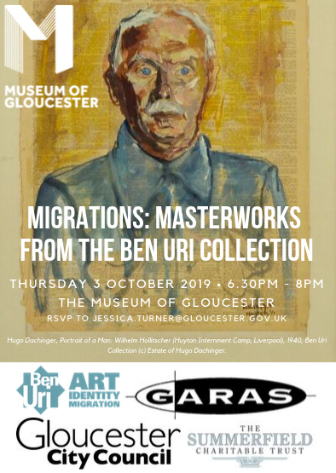
2019 GARAS Refugee Week celebrations

Slide 37
2020
The year starts with a wonderful light & music installation at Gloucester Cathedral called “Where there is light”.
GARAS stays open through Covid and finds different ways to continue supporting the needs of asylum seekers and refugees.
GARAS also helps individuals from the EU to apply for their EU Settlement Status.

Slide 38
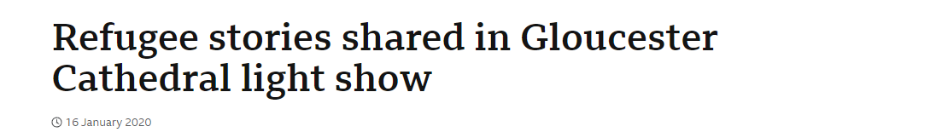
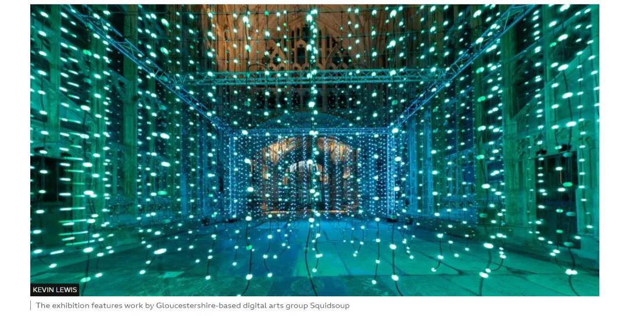

Slide 39
2021
Covid restrictions continue, but so do world affairs.
In August we see the withdrawal from Afghanistan and the chaotic scenes. As a result, the GARAS Resettlement Team expands and works incredibly hard to respond to and meet the needs of those families who come to live in Gloucestershire.
By Christmas we have an urgent new role to play as the first hotels for asylum seekers open in the county.

Slide 40
2022
GARAS continues to work under immense pressure as the support for clients housed in hotels increases. Staff are overwhelmed by support from volunteers and the local community.
Meanwhile another crisis hits home - the invasion of Ukraine by Russia. GARAS works hard to support those arriving on both the Family Visa Route and the Homes for Ukraine scheme. We witness another example of extraordinary public generosity, with homes opened and guests welcomed.

Slide 41
2023
By Autumn, GARAS begins to see the impact of the Home Office’s promise that legacy cases will be dealt with more quickly. Many clients are granted positive decisions more quickly - good news for clients, but an intense challenge in meeting housing needs (the notice to vacate period changes from 28 to 7 days) adding to the ever-increasing workload.
Through effective communication with local authorities, solutions are identified and by the end of the year handing out sleeping bags is no longer a real necessity.
GARAS starts to see the closure of some hotels but also an increase in dispersal housing spread across the county.

Slide 42
2024 – GARAS is 25 years old
The Rwanda Act passes into the Statute books and continues to spread fear into already frightened, vulnerable people. Then fortunately it is repealed by the new Government.
GARAS sees more hotels close, but a growing understanding of the needs of those seeking sanctuary.
This year also sees GARAS celebrate 25 years of being. Original trustees and staff are reminded how sad it is that GARAS needs to exist but are committed to continue to provide services for refugees and asylum seekers as long as necessary, including emergency help, one to one casework, information and sign posting.

Slide 43
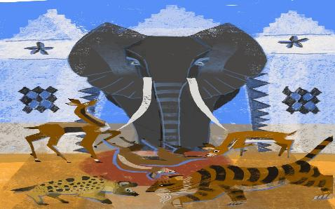
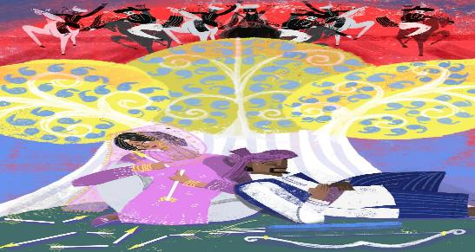
2024 GARAS Refugee Week celebrations
June 2024
PRESS RELEASE
REFUGEE WEEK CELEBRATION EVENT – STORIES FROM OUR HOME
Refugee Week is the world’s largest arts & culture festival celebrating the contributions, creativity and resilience of refugees and people seeking sanctuary, and it was marked in Stroud last Friday at a packed event at the Trinity Rooms, organised by Together With Refugees, (Stroud District).
Gloucestershire storytellers and performers Fiona Eadie and Jude Emmet retold a selection of traditional stories from 25 countries collected from local refugees and asylum seekers to mark Gloucestershire Action for Refugee and Asylum Seeker's (GARAS) 25th birthday. Stories to entertain and provide food for thought from many countries including Kazakhstan, Ethiopia, Iran, Malaysia, Ukraine, South Sudan and Syria. There were stories of love and loss, wit and wisdom, fables, myths, legends, brilliantly brought to life by the two performers. A delicious vegan Somali supper from Bristol-based Somali Kitchen was also on offer and enjoyed by all.
The stories have been beautifully illustrated by multi-talented local artist Zariq, herself a refugee, who also sang a couple of Malaysian songs at the event. A book of the stories and illustrations will be on sale from September, as a fundraiser for GARAS. It will support their work across Gloucestershire, welcoming and supporting those who have fled persecution (including imprisonment, torture and abuse), conflict, famine or hardship in their home country and helping them adjust to their long-term future here if/when they are recognised as ‘refugees’.

Slide 44

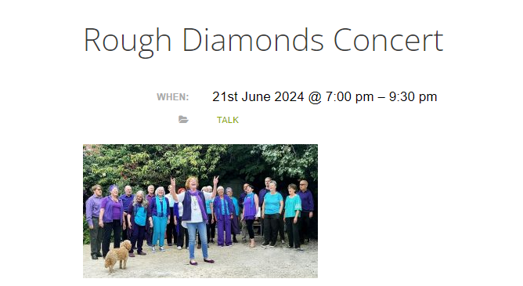
2024 GARAS Refugee Week celebrations
June 2024

Slide 45
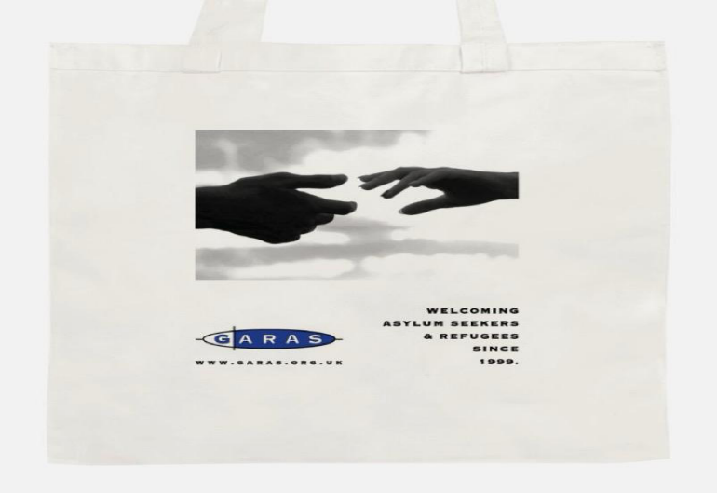
2024 GARAS Refugee Week celebrations.
Limited edition Tote bags
June 2024

Slide 46
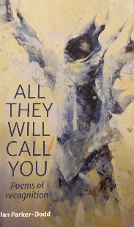
2024 GARAS Refugee Week celebrations
GARAS Volunteer, Ian Parker-Dodd, has written a collection of poetry entitled “All They Will Call You”. Ian shared, “this book was inspired in the time that I spent helping teach unaccompanied migrant children at GARAS for the four years leading up to the Covid pandemic”.
As well as thought provoking, at times provocative poems, there are additional prose contributions from individuals connected to GARAS.
The stunning front cover is a Derek Robertson painting, Children of the Clouds.

Slide 47




Planting A Community Orchard Garden.
In celebration of 25 years of GARAS.
Location: The Summerfield Room, Robinswood Hill Country Park, Reservoir Road, Gloucester, GL4 6SX.
Date: 10:30 am Saturday 25th January 2025.

Slide 48


Slide 49
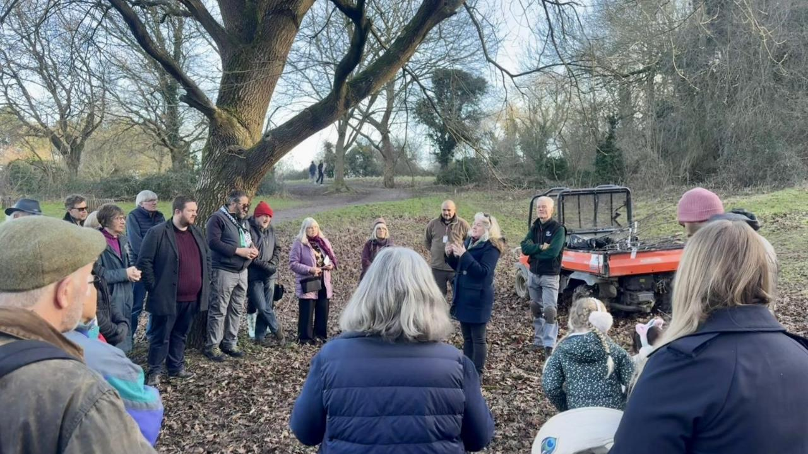
It’s amazing that GARAS (Gloucestershire Action for Refugees and Asylum Seekers) has reached such a meaningful milestone! Celebrating 25 years of providing support to refugees and asylum seekers is a tremendous accomplishment, and it’s an opportunity to honour the people who have made that work possible — from the Trustees, staff, volunteers to the donors and partners. We thank you all.

Slide 50
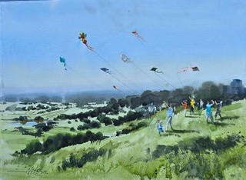
Thank you for taking the time to follow our journey.
Please stay in touch with us by visiting our website, where you can find regular updates of our work.
https://www.garas.org.uk/

